Slide 1
Regression
Logistic Regression

Slide 2
A Problem with Linear Regression
However, transforming the independent variables does not remedy all of the potential problems. What if we have a non-normally distributed dependent variable? The following example depicts the problem of fitting a regular regression line to a non-normal dependent variable).
Suppose you have a binary outcome variable. The problem of having a non-continuous dependent variable becomes apparent when you create a scatterplot of the relationship. Here, we see that it is very difficult to decipher a relationship among these variables.

Slide 3
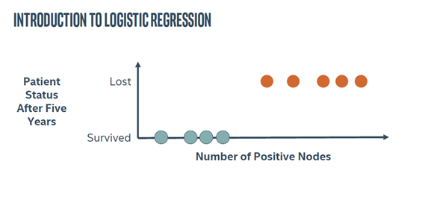

Slide 4
A Problem with Linear Regression
We could severely simplify the plot by drawing a line between the means for the two dependent variable levels, but this is problematic in two ways: (a) the line seems to oversimplify the relationship and (b) it gives predictions that cannot be observable values of Y for extreme values of X.
The reason this doesn’t work is
because the approach is analogous to
fitting a linear model to the probability
of the event. As you know,
probabilities can only take values
between 0 and 1. Hence, we need a
different approach to ensure that our
model is appropriate for the data.

Slide 5
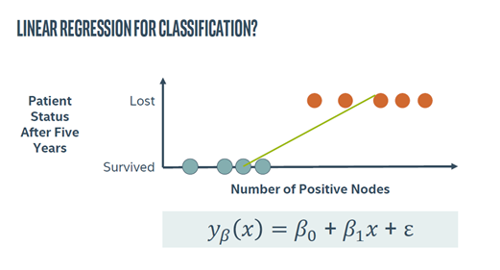

Slide 6
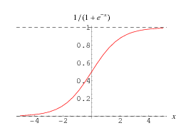
A Problem with Linear Regression
If you think about the shape of this distribution, you may posit that the function is a cumulative probability distribution. As stated previously, we can model the nonlinear relationship
between X and Y by transforming one of the variables. Two common transformations that result in sigmoid functions are probit and logit transformations. In short, a probit
transformation imposes a cumulative normal function on the data. But, probit functions are difficult to work with because they require integration. Logit transformations, on the other hand, give nearly identical values as a probit function, but they are much easier to work with because the function can be simplified to a linear equation.

Slide 7
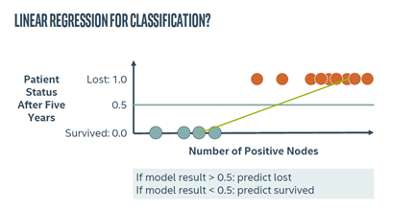

Slide 8
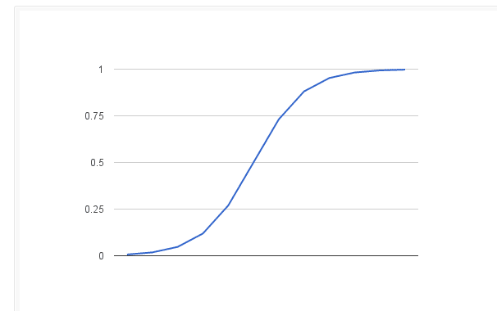

Slide 9
What is Logistic Regression?
Logistic regression is often used because the relationship between the DV (a discrete variable) and a predictor is non-linear
Example from the text: the probability of heart disease changes very little with a ten-point difference among people with low-blood pressure, but a ten point change can mean a drastic change in the probability of heart disease in people with high blood-pressure.

Slide 10
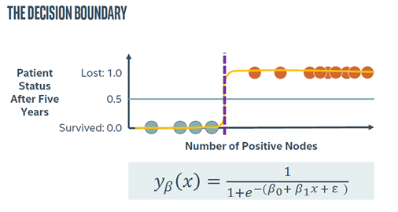

Slide 11
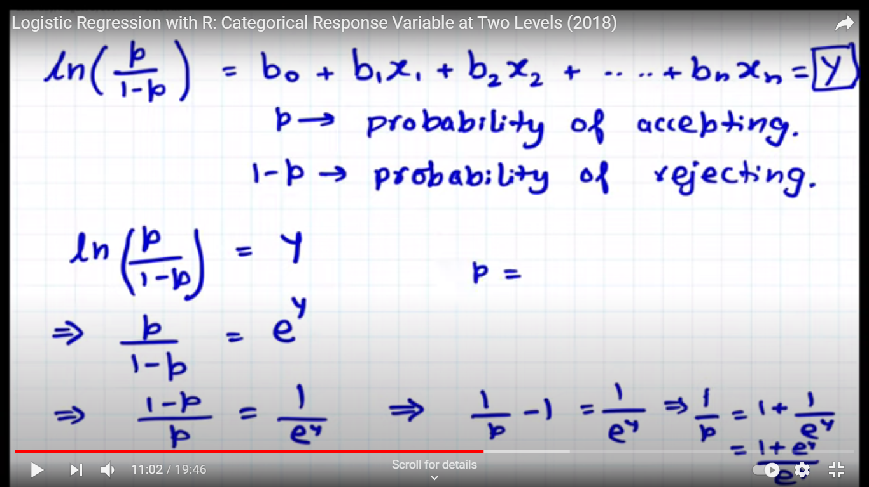
Sigmoid Function—Logistic regression

Slide 12
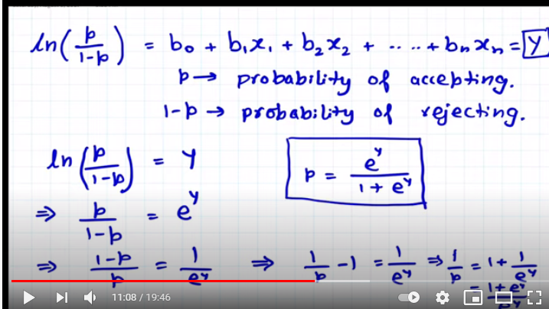

Slide 13
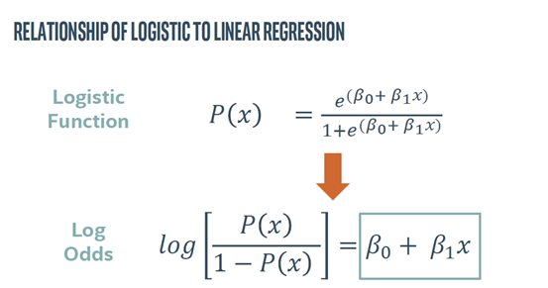

Slide 14
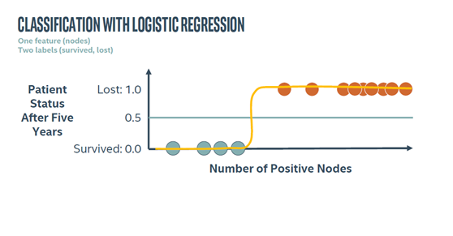

Slide 15
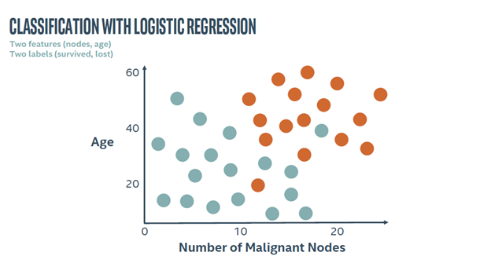

Slide 16
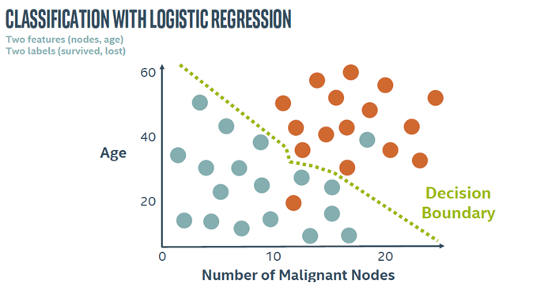

Slide 17
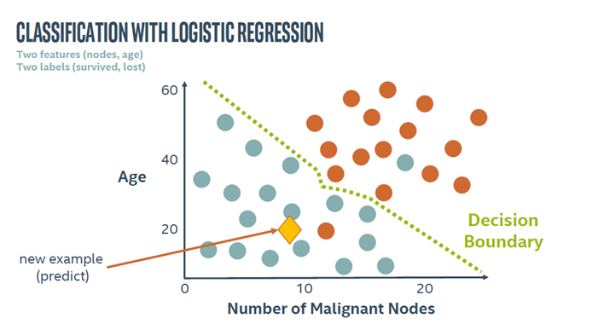

Slide 18
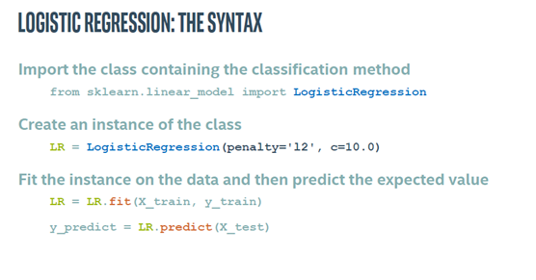

Slide 19
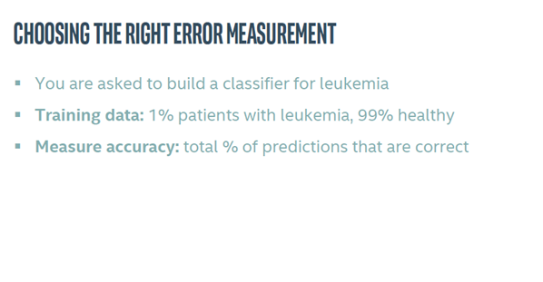
Classification error metrics

Slide 20
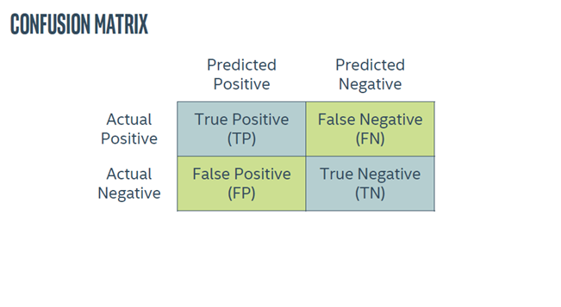

Slide 21
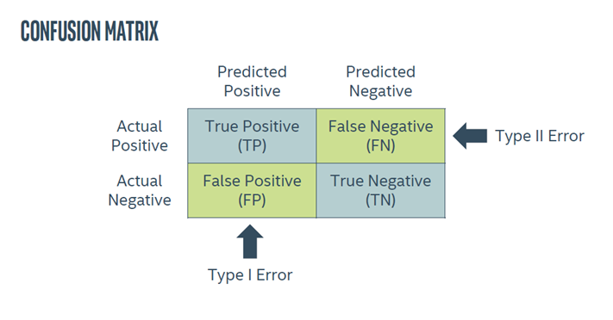

Slide 22
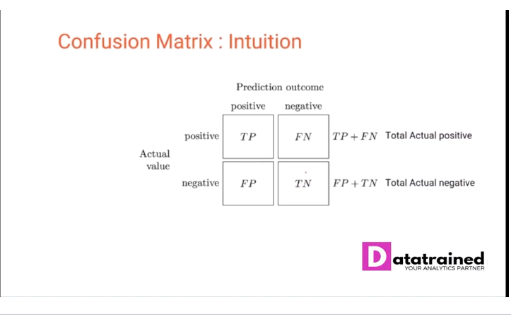

Slide 23
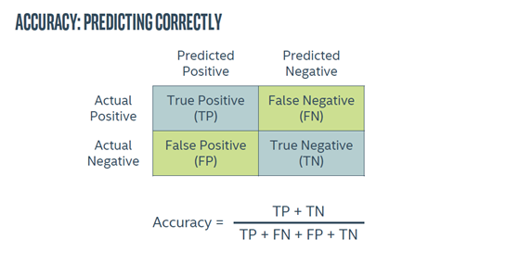

Slide 24
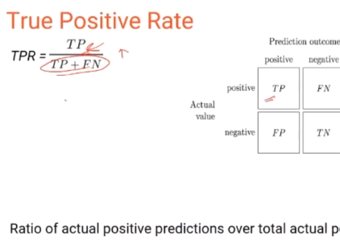
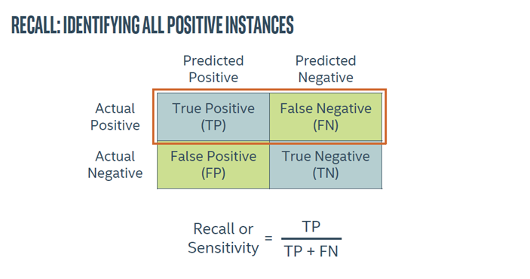
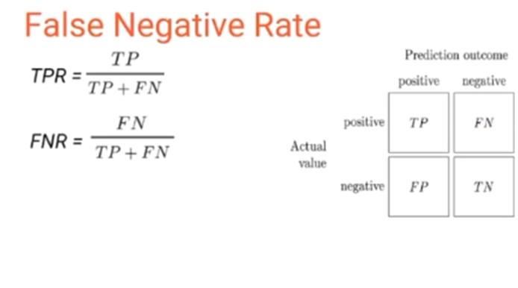

Slide 25
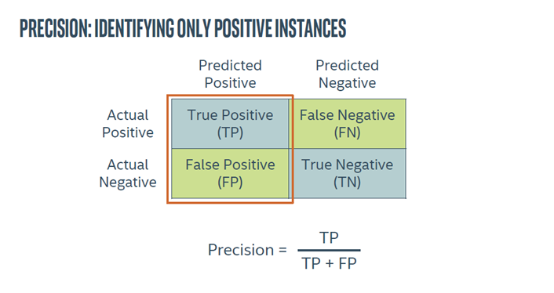

Slide 26
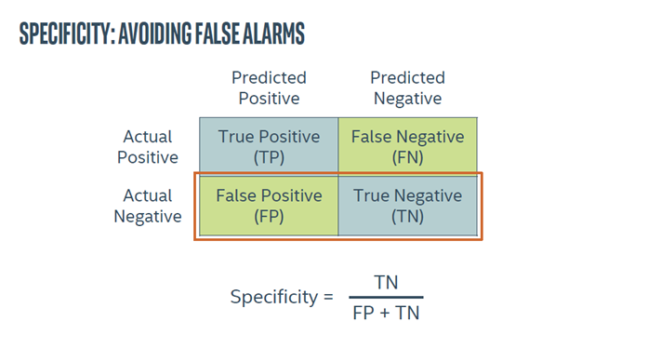

Slide 27
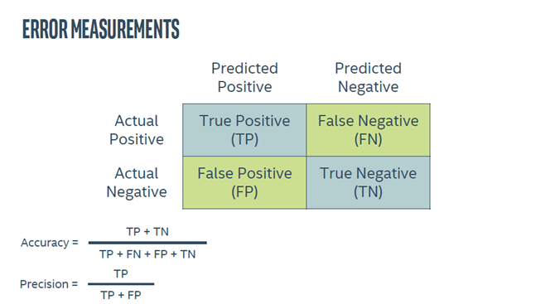

Slide 28
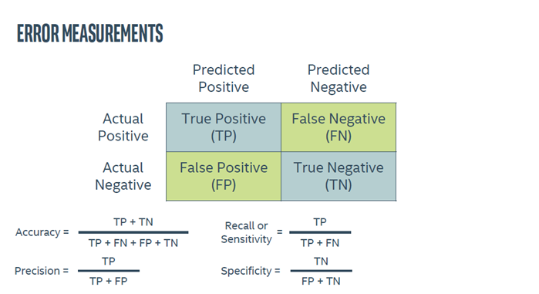

Slide 29
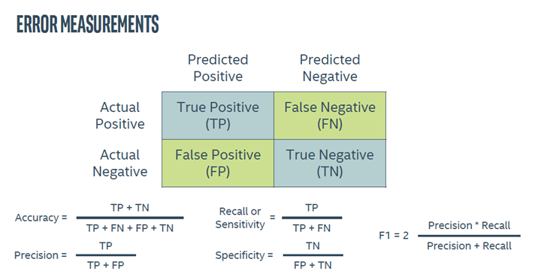

Slide 30
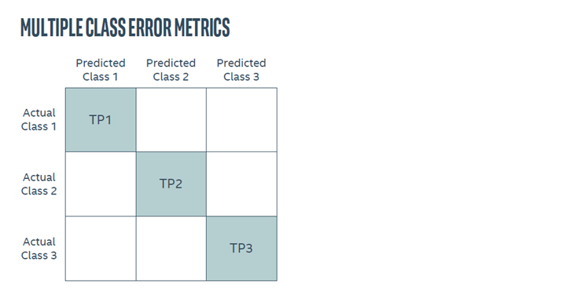

Slide 31
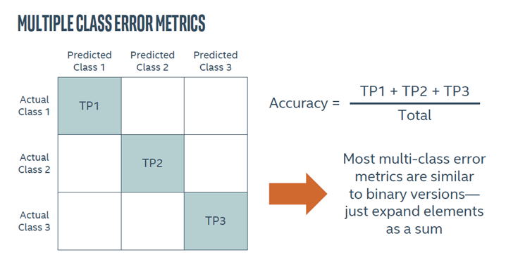

Slide 32
